Slide 1


SMART DOOR
GPCET
REVIEW
2022
PRESENTED BY :
ADNAN ALI

Slide 2
AGENDA
What is proximity IR sensor , and how to interface it with esp32?
What is l293d motor driver module and dc motor and interfacing with esp32 microcontroller?
What if I tell you that the door opens automatically each time you go infront of it?
Also you can control your door using google assistant from any where.
Hence to meet these requirements we came up with a solution , “The Smart Door”.
GPCET
REVIEW
2022

Slide 3

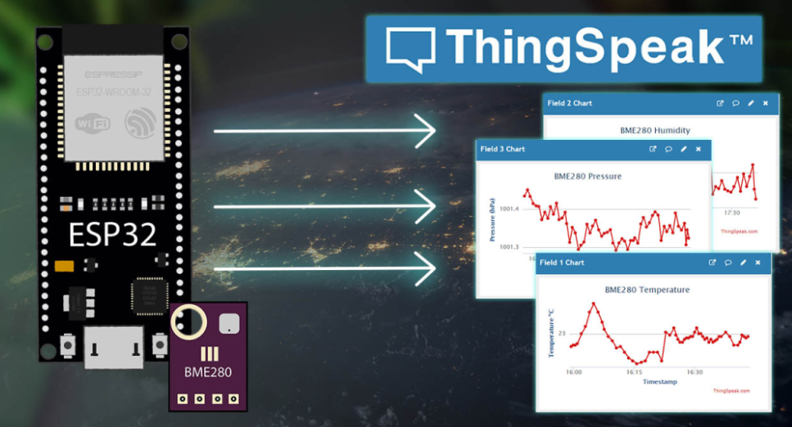

LIST OF SOFTWARES USED :
1. Arduino IDE :
Arduino IDE Is An Integrated Development Environment Which Enable Us To Program And Upload The Codes Onto Different Types Of Microcontrollers Like Arduino , Esp32, Esp8266..Etc
2. ThingSpeak Cloud platform :
Thingspeak Is A “PaaS” Cloud Platform Which Is Student Oriented Which Helps Students Build Projects Based On Cloud Applications And Use Multiple Of Their Features For Free.
3. IFTTT - IF THIS THEN THAT :
IFTTT Helps Connect Different Apps And Devices., We Can Enable Our Apps And Devices To Work Together To Do Things . Ex : Controlling Lights Using Google Assistant , Sending A Notification When Temperature Rises The Threshold Value Etc..
GPCET
REVIEW
2022

Slide 4
LIST OF LIBRARIES USED :
1. <WiFi.h>
To include ESP32 board in Arduino IDE and use its wifi connectivity features.
2. <ThingSpeak.h>
To write data to ThingSpeak cloud and read data from ThingSpeak cloud.
And to use multiple features of ThingSpeak platform
GPCET
REVIEW
2022

Slide 5
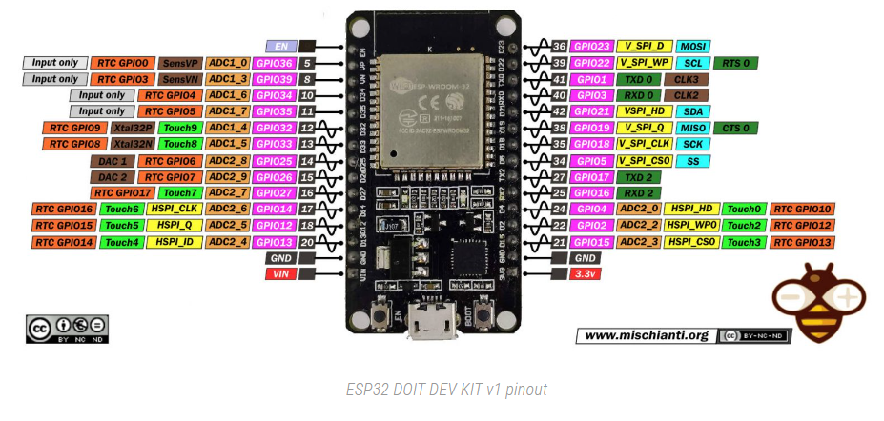
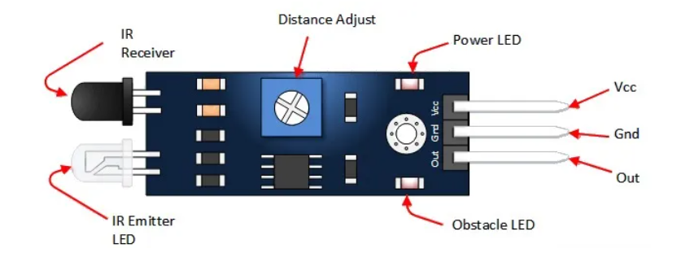
HARDWARE AND ITS USES :
ESP32 MICROCONTROLLER :
PROXIMITY IR SENSOR :
ESP32 is a series of low-cost, microcontroller with integrated WiFi and dual-mode Bluetooth.
An infrared sensor is an electronic sensor which is used to sense physical objects in its surroundings by either emitting or detecting infrared radiation.
GPCET
REVIEW
2022

Slide 6
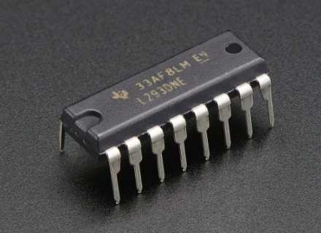
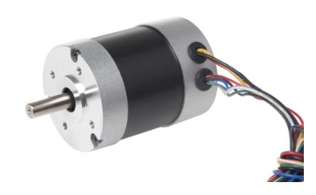
HARDWARE AND ITS USES :
L293D IC MODULE:
DC MOTOR :
L293D is a typical Motor driver IC which allows DC motor to drive on either direction. L293D is a 16-pin IC which can control a set of two DC motors simultaneously in any direction.
A DC motor is defined as a class of electrical motors that convert DC electrical energy into mechanical energy. Any electric motor that is operated using direct current or DC is called a DC motor.
GPCET
REVIEW
2022

Slide 7
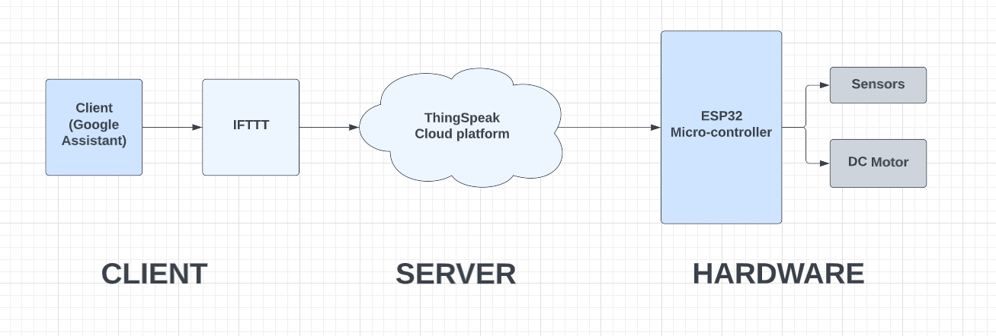
BLOCK DIAGRAM OF SMART-DOOR
GPCET
REVIEW
2022

Slide 8
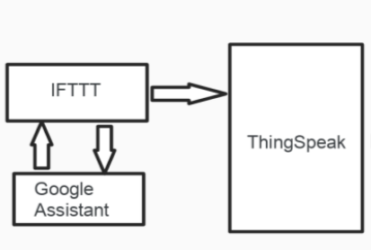
BLOCK DIAGRAM ( CLIENT )
GPCET
REVIEW
2022

Slide 9
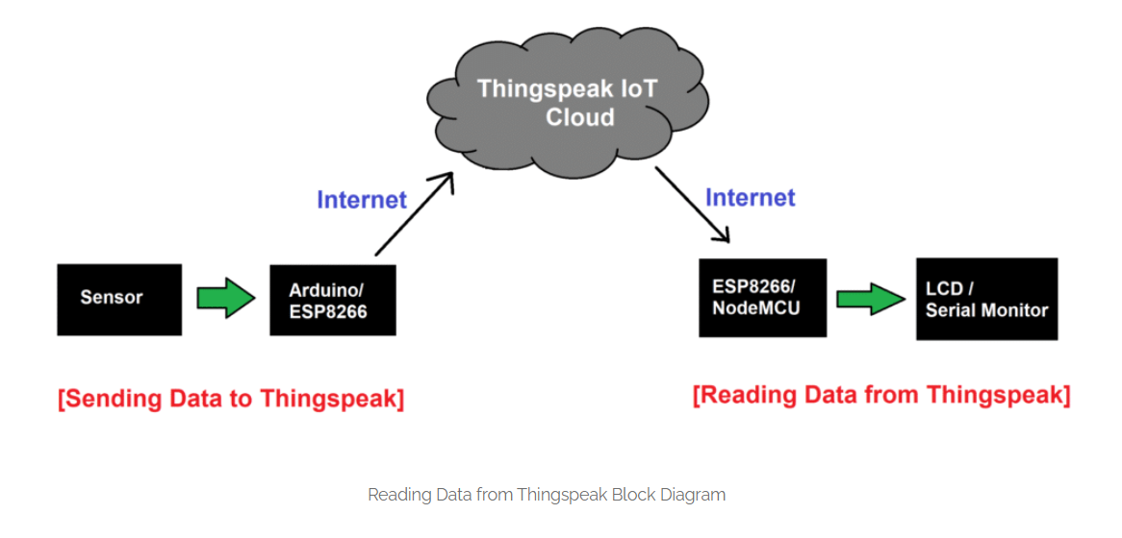
BLOCK DIAGRAM ( SERVER )
GPCET
REVIEW
2022

Slide 10
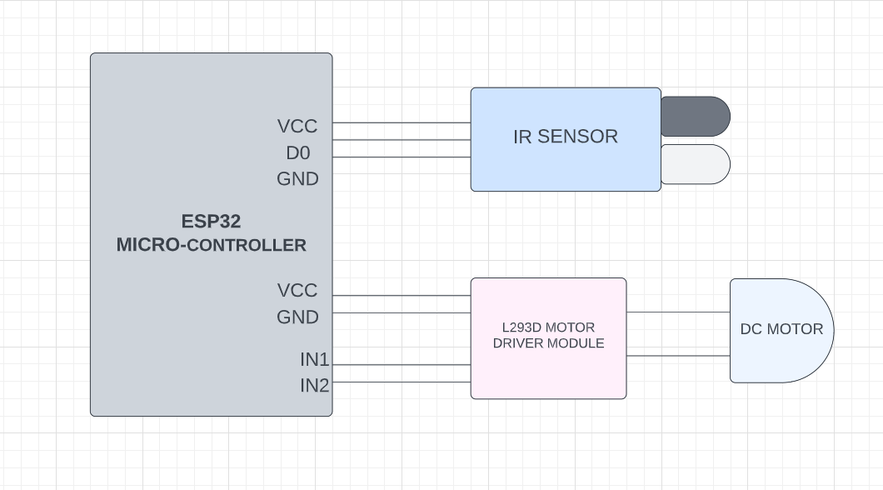
CIRCUIT DIAGRAM OF HARDWARE
GPCET
REVIEW
2022

Slide 11
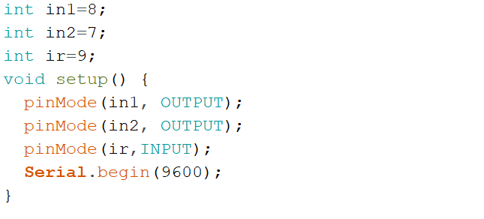
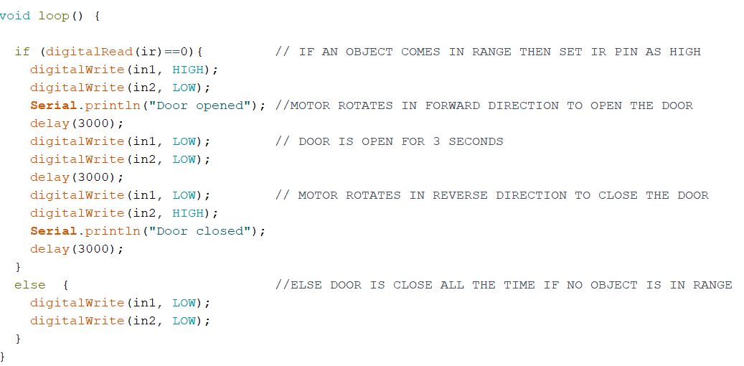
PROGRAM
FIRST INITIALIZING THE PINS AND SETTING THEM AS INPUT / OUTPUT PINS AND WRITING LOGIC :
GPCET
REVIEW
2022

Slide 12
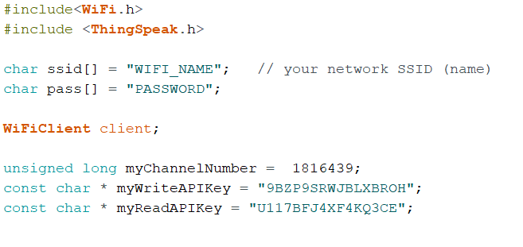
PROGRAM LOGIC FOR THINGSPEAK
READING VALUE FROM THINGSPEAK CLOUD AND WRITING CONDITIONS :
1. IMPORTING LIBRARIES AND INITIALIZING API KEYS.
GPCET
REVIEW
2022

Slide 13
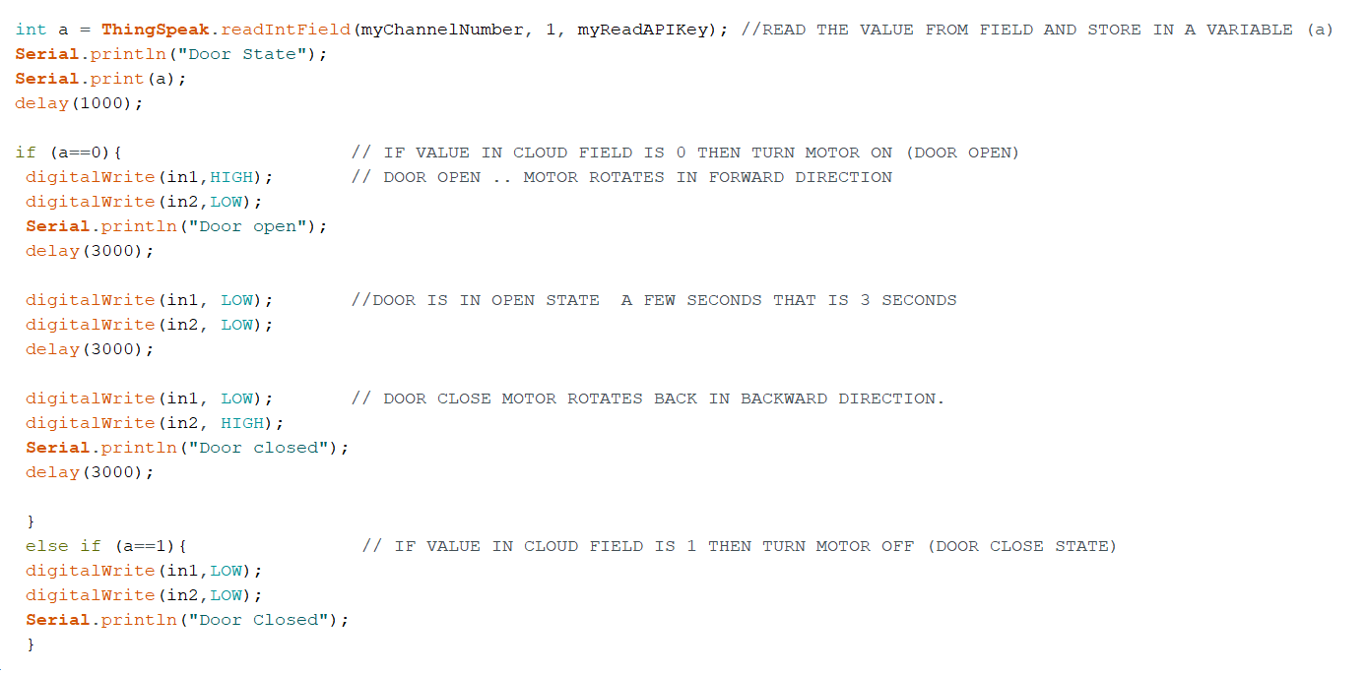
PROGRAM LOGIC FOR THINGSPEAK
2. READ VALUES FROM THINGSPEAK PLATFORM AND WRITE CONDITION
GPCET
REVIEW
2022

Slide 14
IMPLEMENTATION
MAKE ALL THE CONNECTIONS AS PER THE CIRCUIT DIAGRAM
2. CREATING CHANNEL ON THING ThingSpeak CLOUD PLATFORM
3. CREATING TRIGGERS ON IFTTT PLATFORM.
4. COMPILING AND UPLOADING THE PROGRAM IN ARDUINO IDE.
GPCET
REVIEW
2022

Slide 15
1. MAKING HARDWARE CONNECTIONS AS PER CIRCUIT DIAGRAM
GPCET
REVIEW
2022

Slide 16
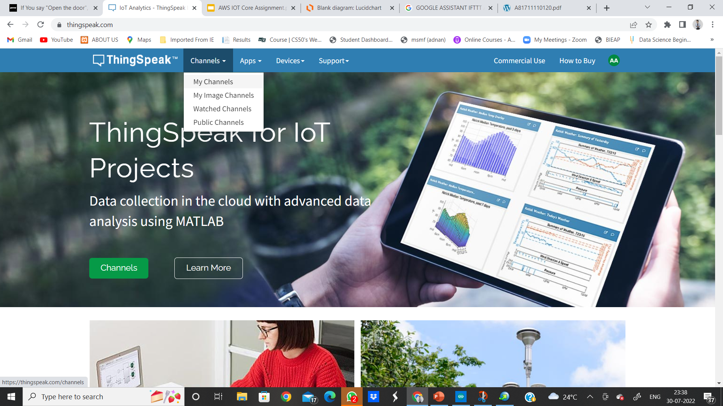
2. CREATING CHANNEL AND FIELDS ON THINGSPEAK
GPCET
REVIEW
2022

Slide 17
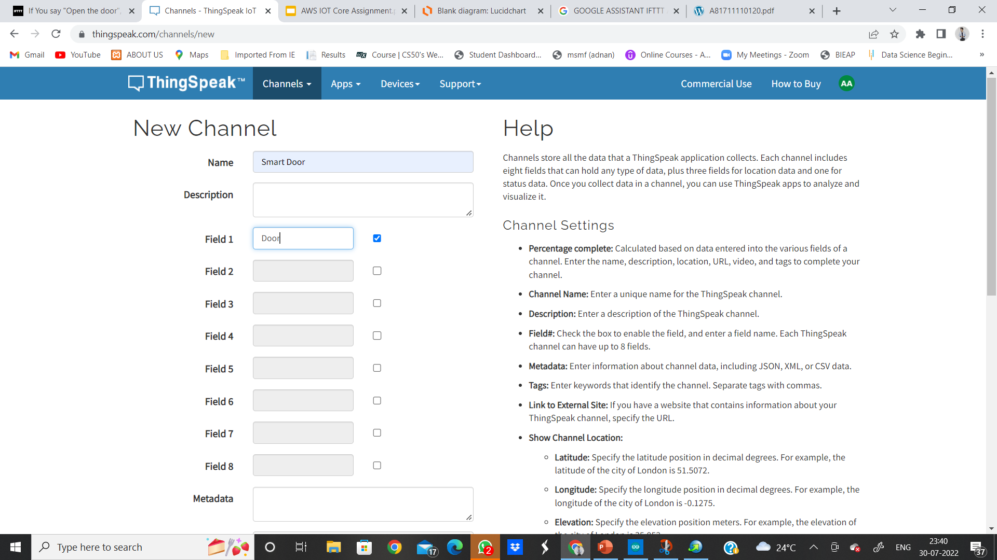
IN MY CHANNEL –> NEW CHANNEL –> FILL ALL DETAILS AS FOLLOWS
GPCET
REVIEW
2022

Slide 18
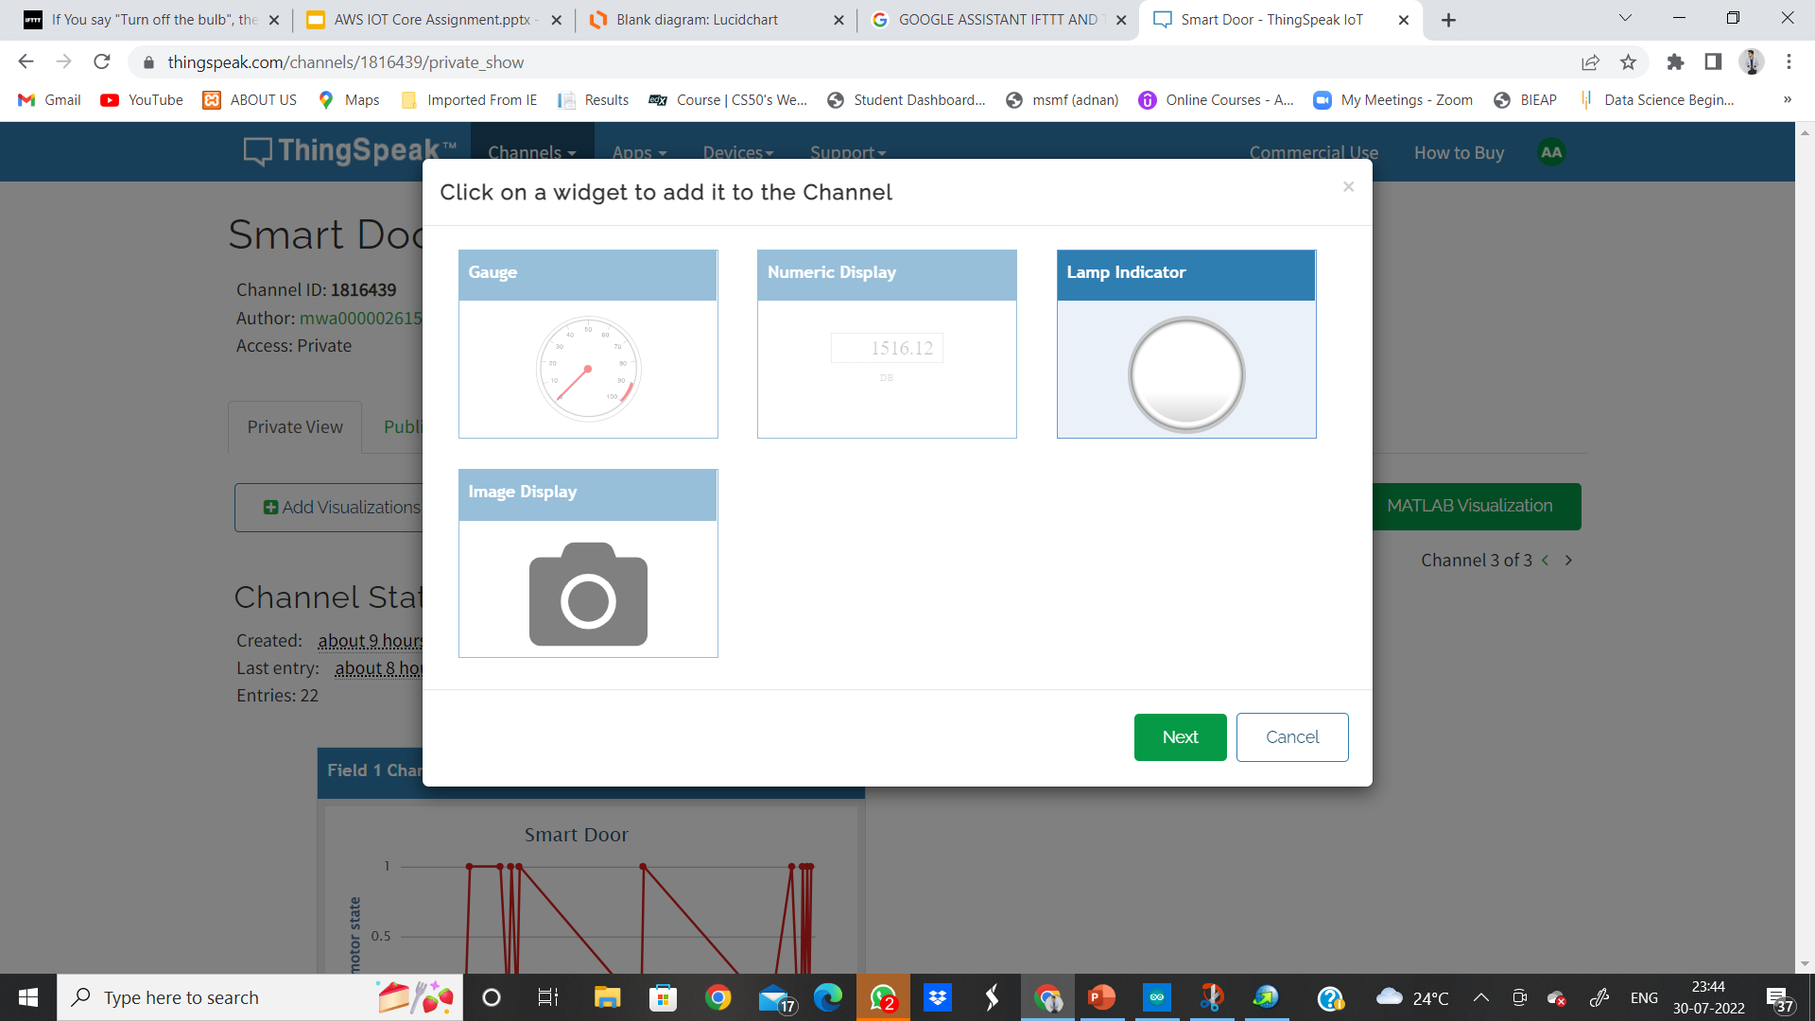
ONCE A CHANNEL IS CREATED → ADD WIDGET→SELECT LAMP INDICATOR
GPCET
REVIEW
2022

Slide 19
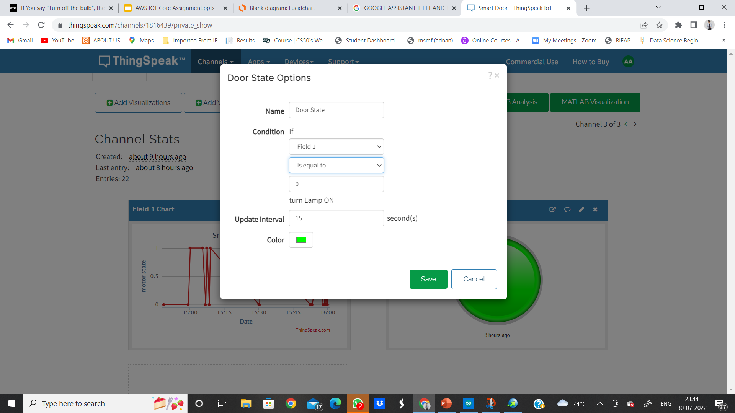
AFTER ADD WIDGET → FILL ALL THE DETAILS AND GIVE CONDITION AS ON WHEN FIELD1==0 .
GPCET
REVIEW
2022

Slide 20
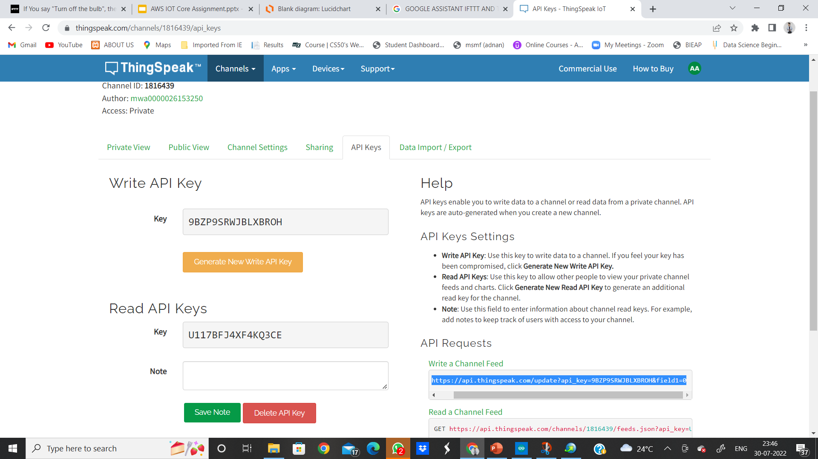
IN MY CHANNEL → API KEYS → AND COPY THE READ &WRITE API KEY AND ALSO THE HIGHLIGHTED URL
GPCET
REVIEW
2022

Slide 21
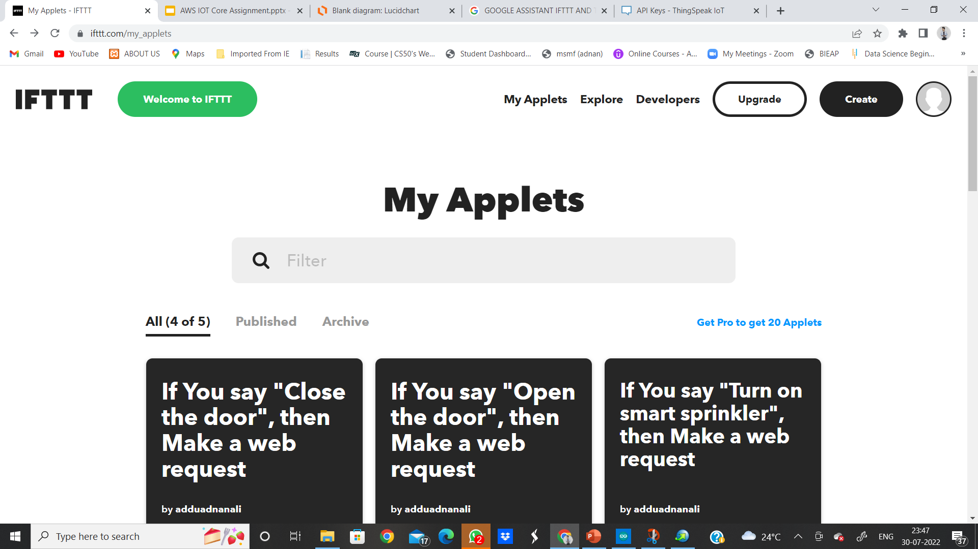
3. CREATING TRIGGERS ON IFTTT PLATFORM.
GPCET
REVIEW
2022

Slide 22
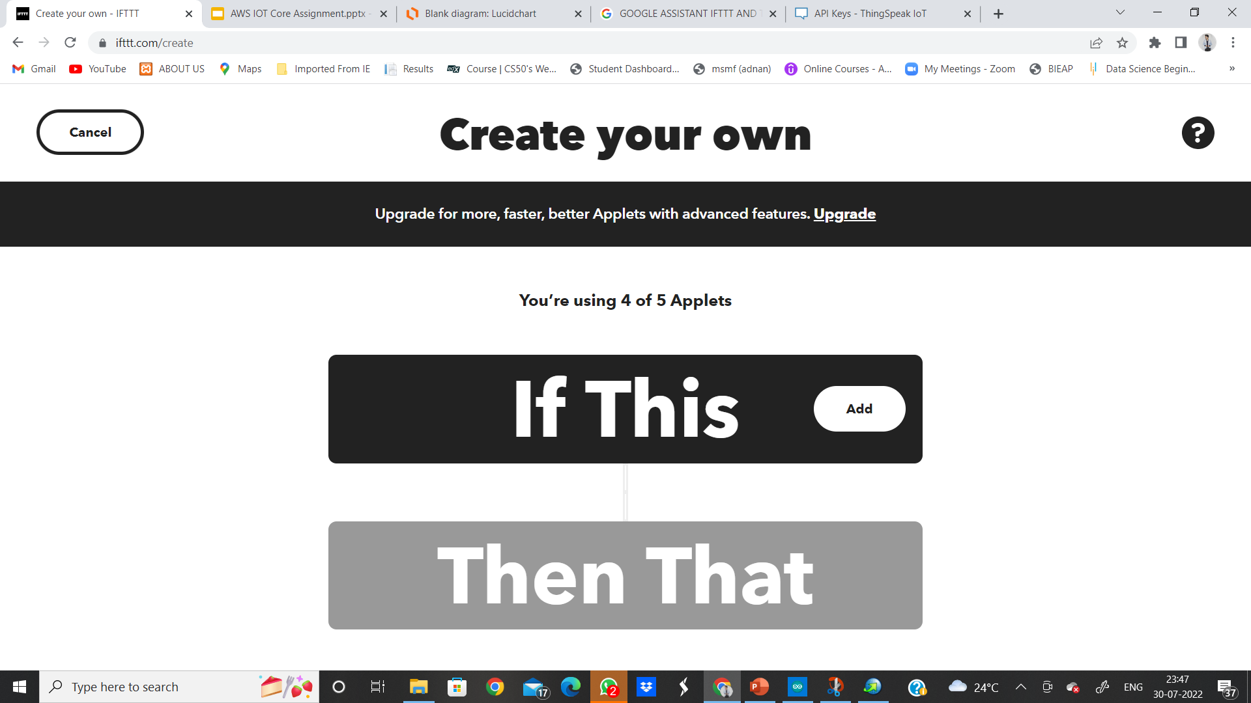
AFTER LOGGING IN IFTTT PLATFORM →CREATE
GPCET
REVIEW
2022

Slide 23
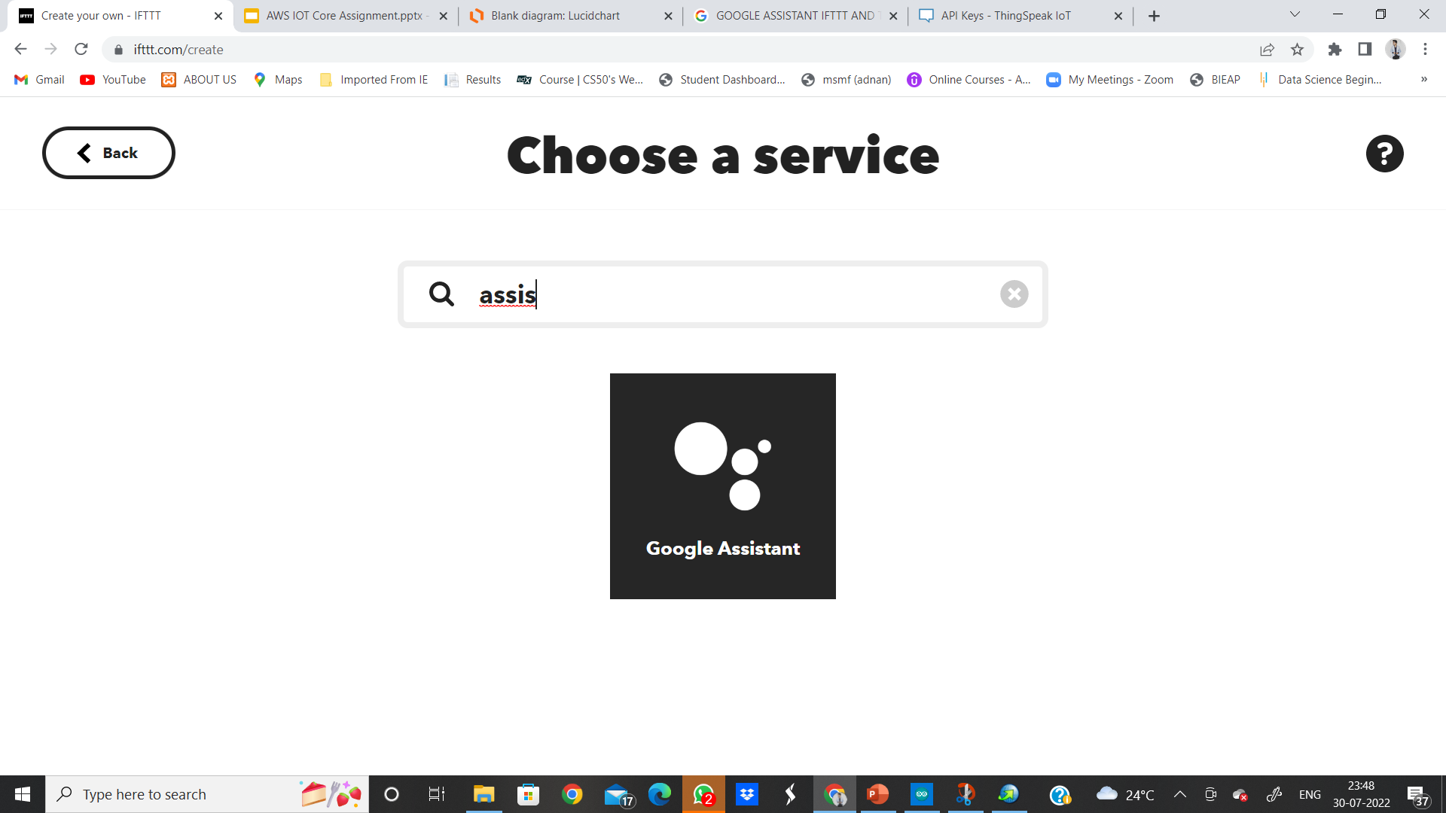
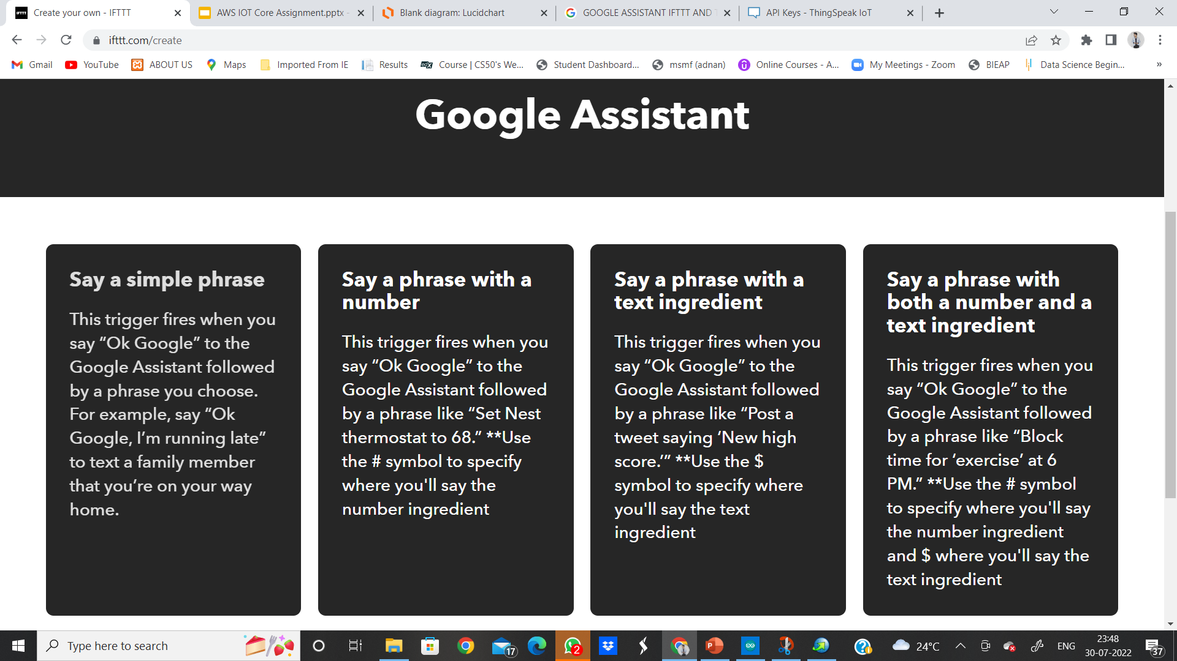
GPCET
REVIEW
2022

Slide 24
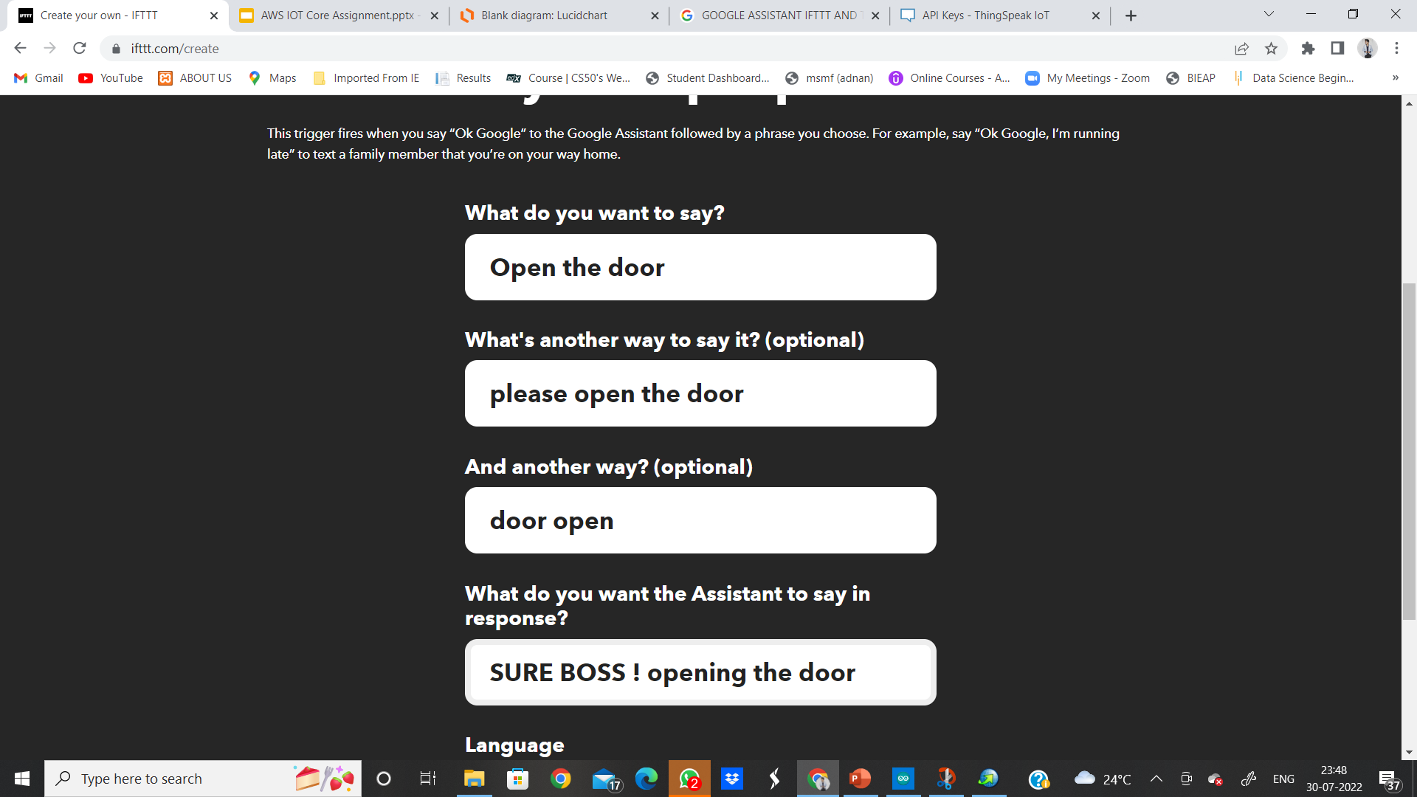
GPCET
REVIEW
2022

Slide 25
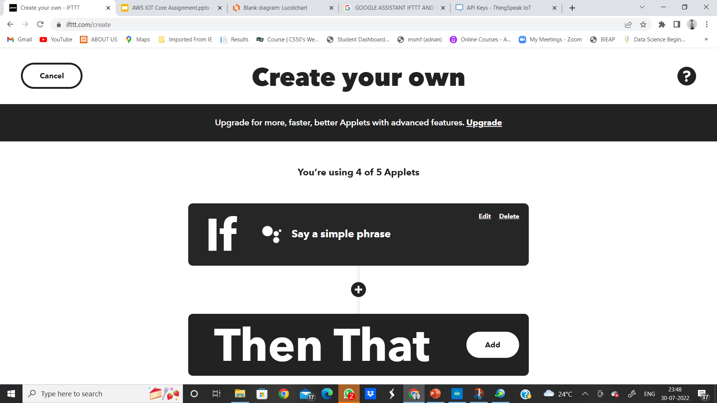
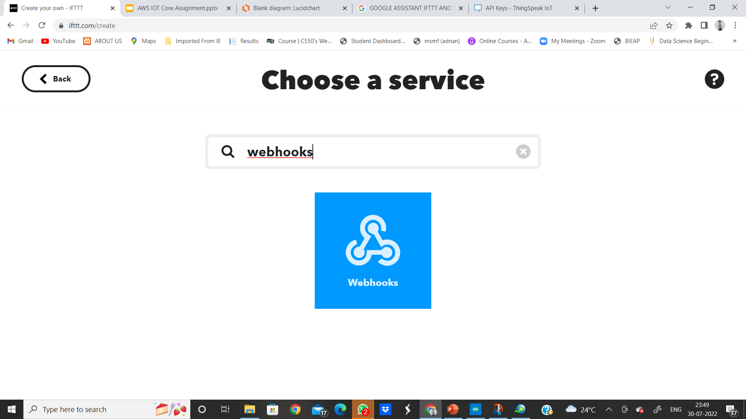
NOW CONDITION FOR THEN THAT IN IFTTT
GPCET
REVIEW
2022

Slide 26
REMEMBER THE WRITE FIELD URL WHICH WE COPIED IN OUR CHANNEL API KEYS IN THINGSPEAK THE SAME URL HAS TO BE PASTED IN WEB HOOKS.
GPCET
REVIEW
2022

Slide 27
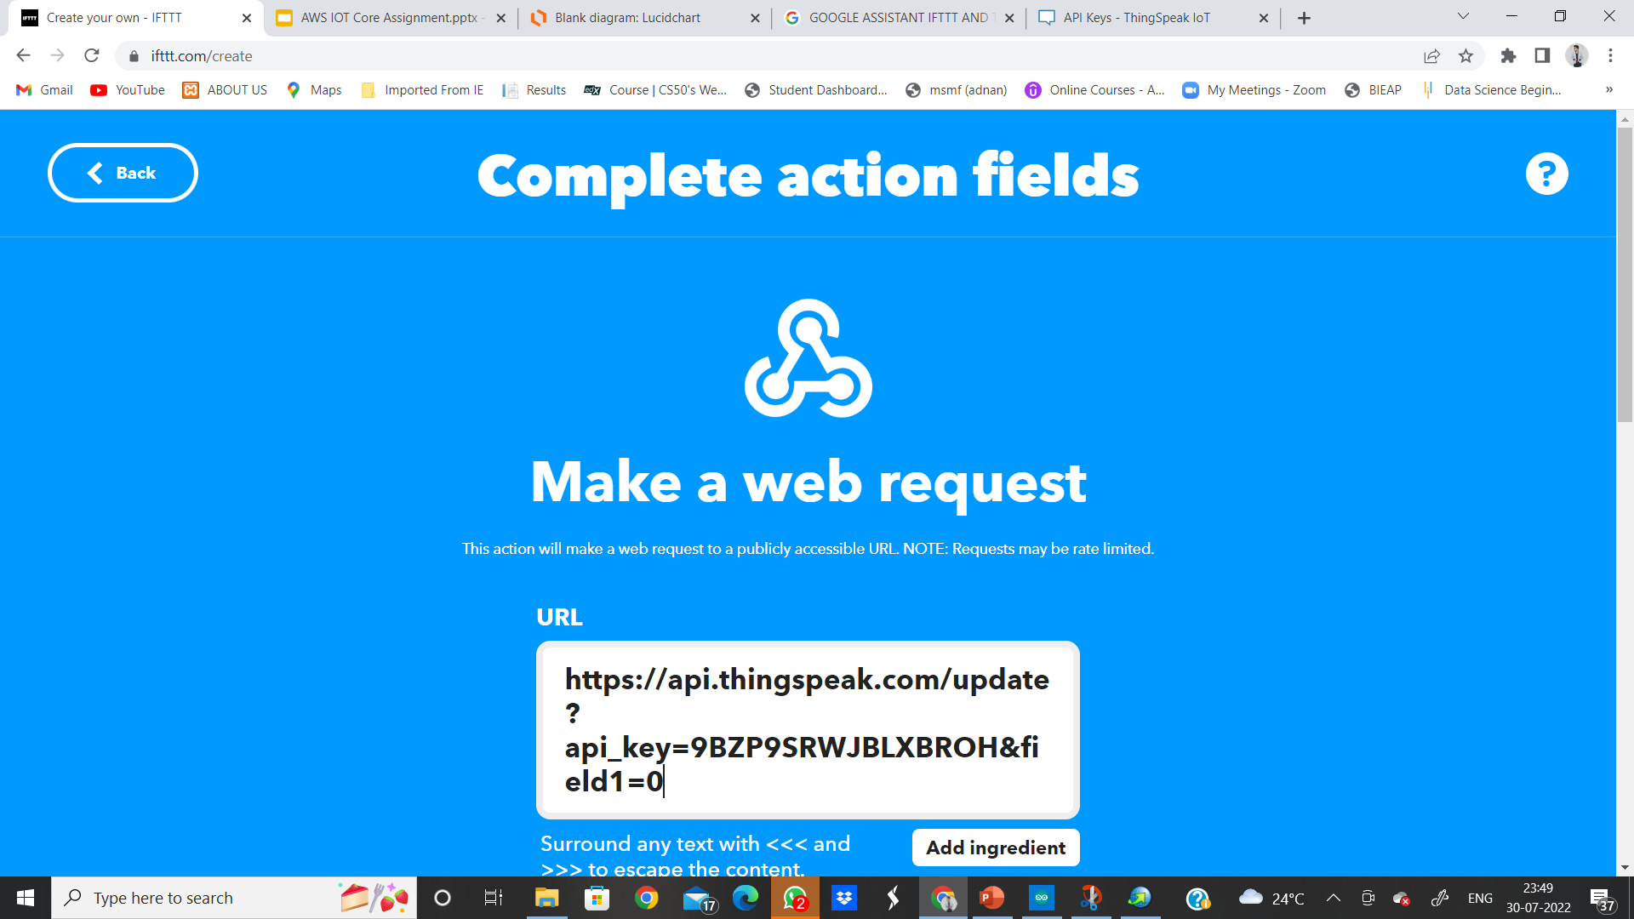
MAKE SURE THAT THE END OF URL IS “FIELD1=0”, AS WE ARE CREATING THE TRIGGER FOR OPEN DOOR THE STATE SHOULD BE ‘0’ AS GIVEN IN THINGSPEAK FIELD CONDITION.
GPCET
REVIEW
2022

Slide 28
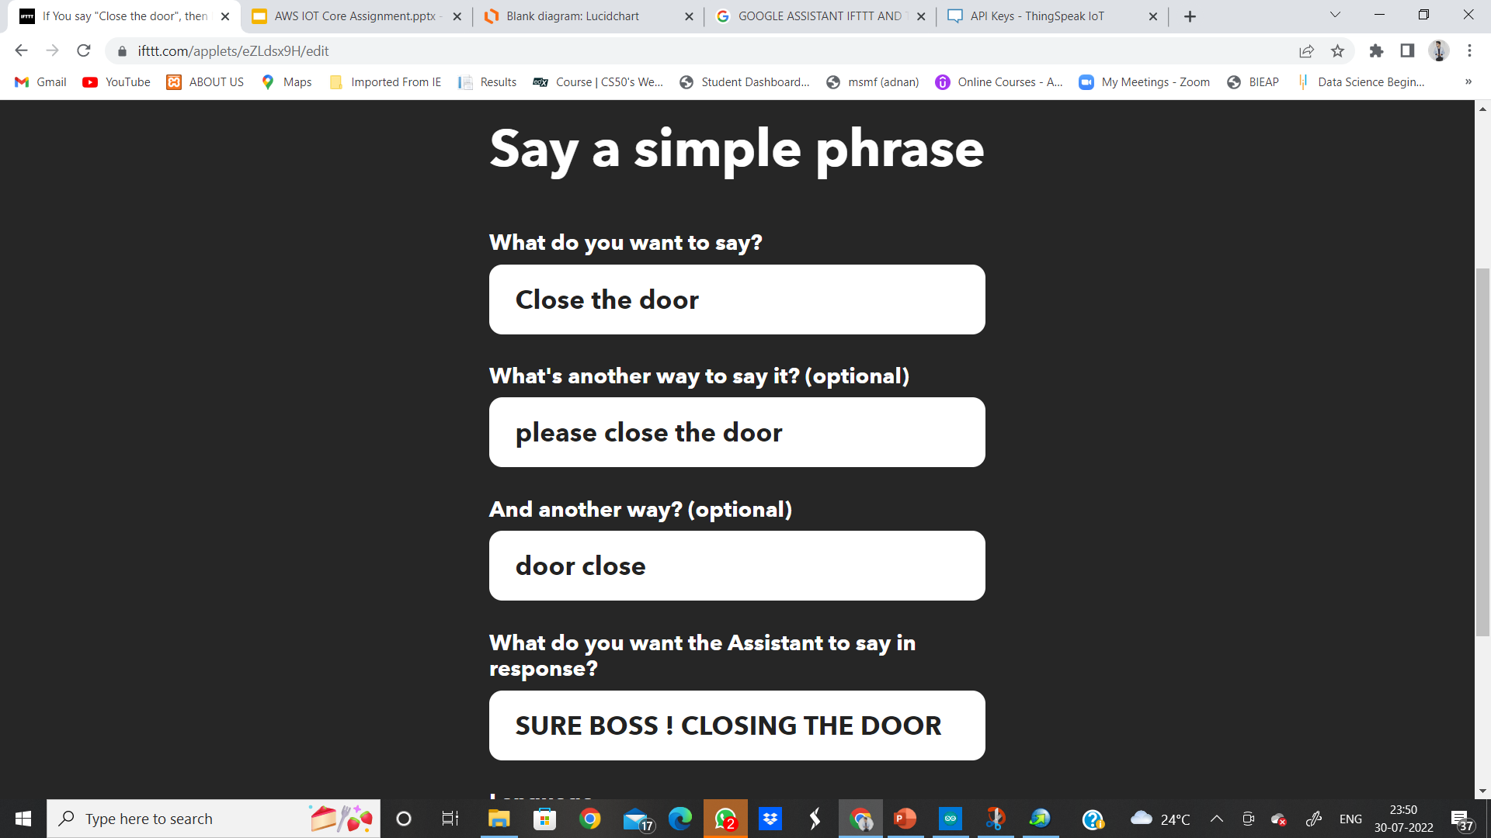
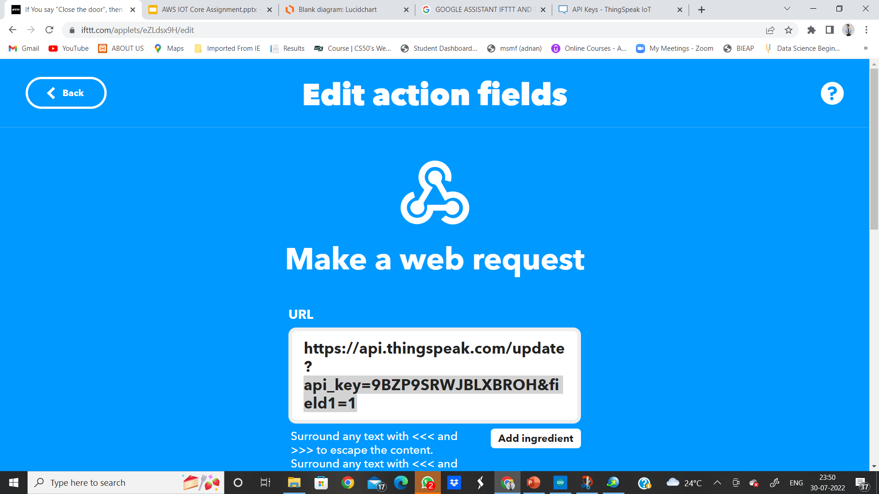
FOLLOW SIMILAR STEPS TO CREATE ANOTHER APPLET FOR DOOR CLOSE , BUT ONLY CHANGE HERE IS THAT THE WEBHOOK WILL END WITH “field1=1”
GPCET
REVIEW
2022

Slide 29
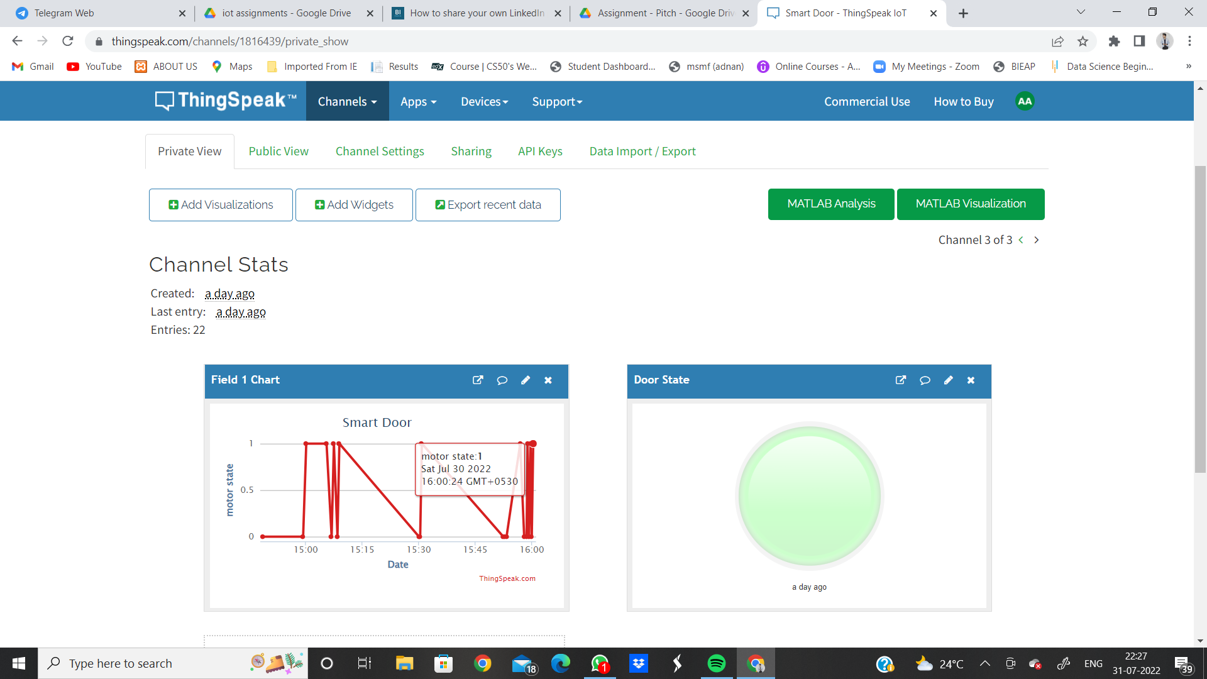

Slide 30
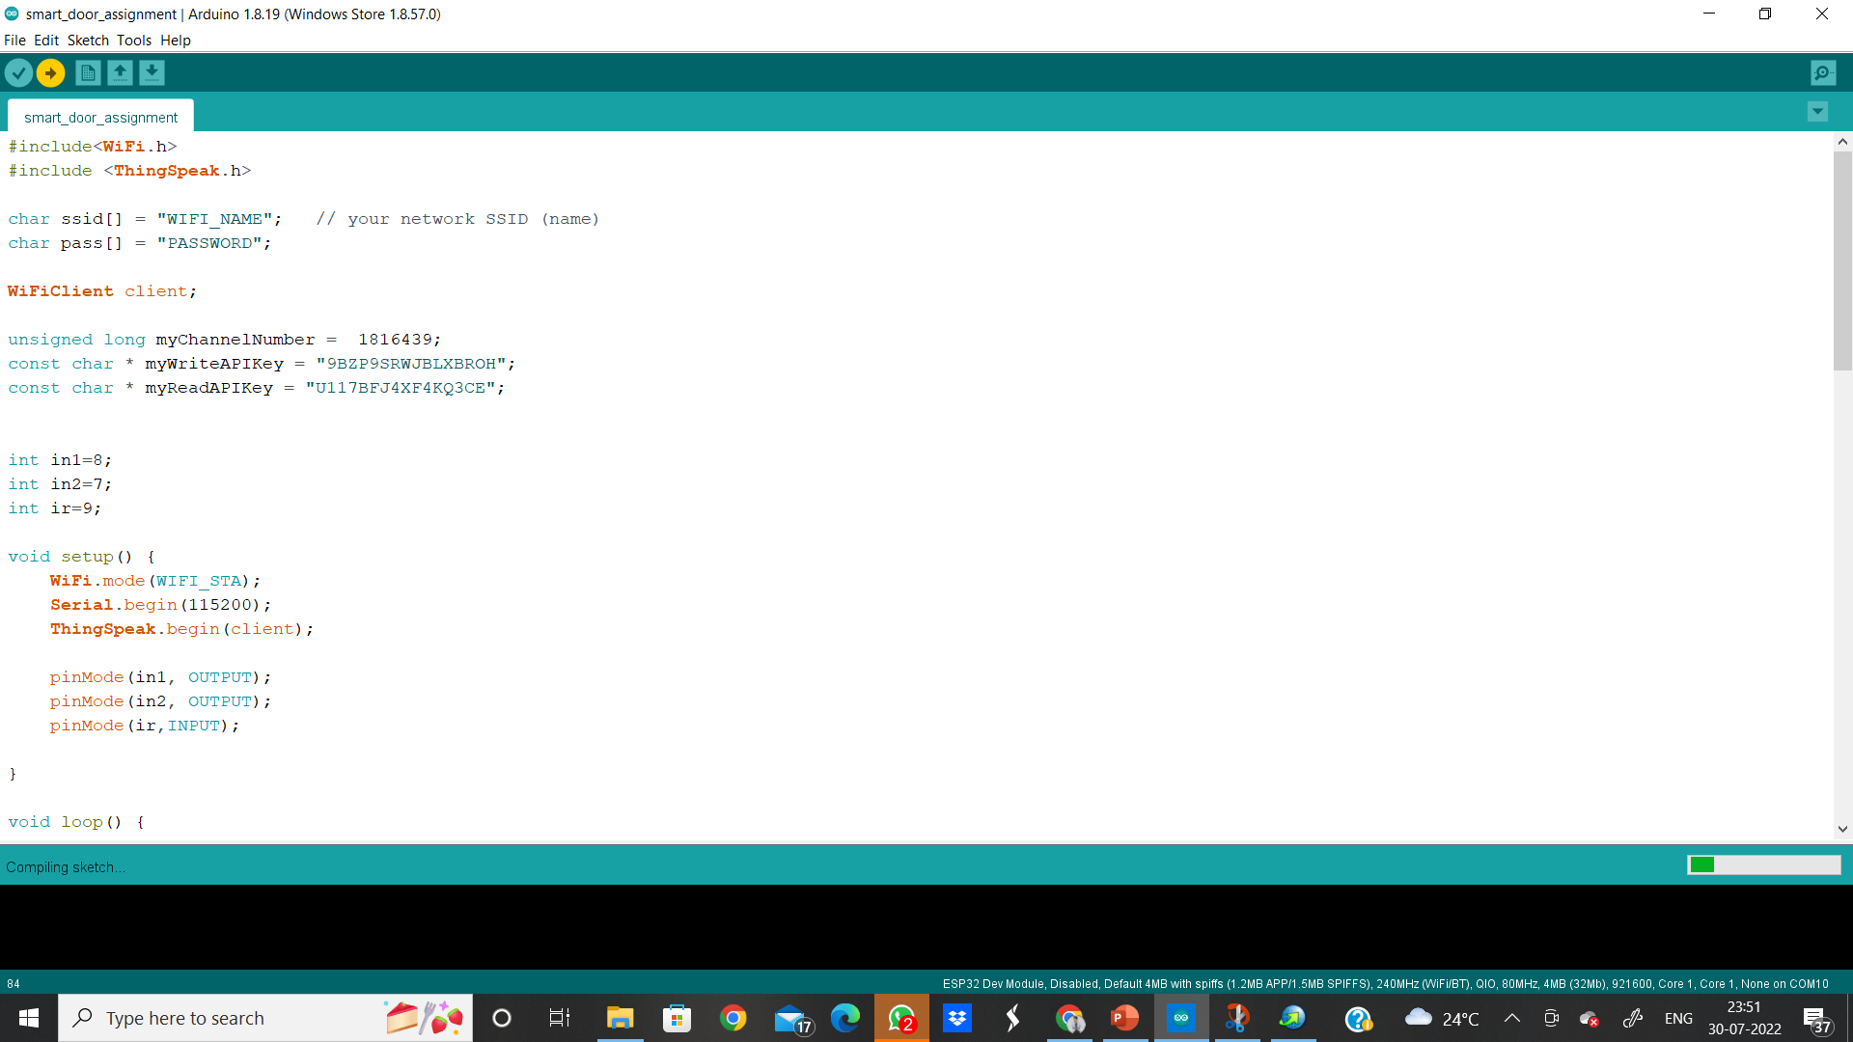
4. COMPILING AND UPLOADING THE PROGRAM
GPCET
REVIEW
2022

Slide 31
CONCLUSION
UPON COMPLETION OF THE ASSIGNMENT WE GOT TO LEARN:
1. HOW TO INTERFACE DC MOTOR AND IR SENSOR WITH ESP32 MICROCONTROLLER.
2. HOW TO WRITE AND READ DATA FROM THING SPEAK CLOUD PLATFORM.
3. HOW TO CREATE TRIGGERS USING IFTTT PLATFORM.
4. CREATING A SMART DOOR APPLICATION THAT OPENS AUTOMATICALLY EVERYTIME AN OBJECT COMES INFRONT OF IT AND CLOSES AFTER SOME TIME.
5. TO CONTROL DOOR FROM ANYWHERE USING GOOGLE ASSISTANT.
GPCET
REVIEW
2022

Slide 32
THANK YOU EVERYONE! YOU GUYS HAVE BEEN A WONDERFUL AUDIENCE THAT’S IT FROM OUR SIDE. HAVE A MARVELOUS MONDAY
GPCET
REVIEW
2022

